Slide 1

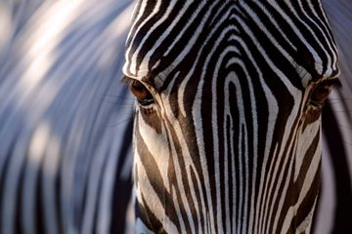
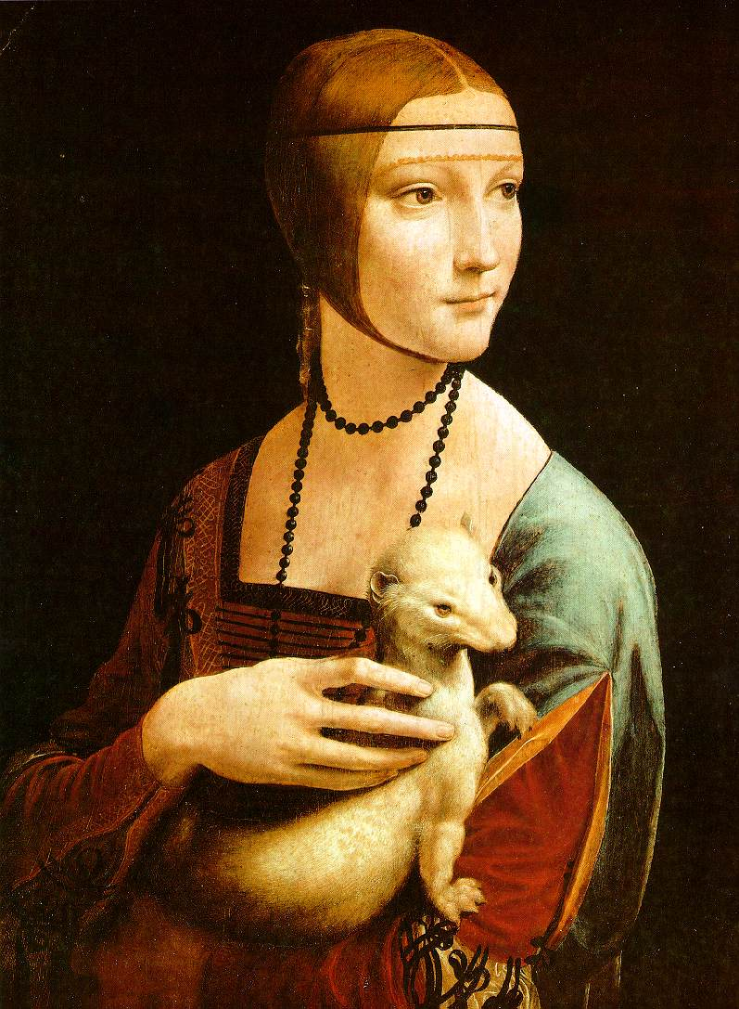


Computational vision: INTROduction
Class 1: Computational Vision
2021-2022

Slide 2
Today:
Subject organization
What is Computational Vision?
A little bit of history
Main problems of Computational Vision
Difficulties of the Computational Vision
Applications
Bibliography

Slide 3
Course organization
Lecturers:
• Petia Ivanova Radeva (petia.ivanova@ub.edu)
• Bhalaji Nagarajan (bhalaji10@gmail.com)
• Course schedule:
Theory classes: Tuesday 14:00h -15:30h
Practical classes:
• Group A: Tuesday 15:30h-17:00h IF
• Group B: Tuesday 17:00h-18:30h IF

Slide 4
Organization
• Online classes:
• Presentations introducing theoretical concepts, questions about the
material, solve exercises, do questionnaires, …
• Practicum:
• Python based projects
• Material:
• Presentations introducing theoretical concepts, videos, readings,
exercises and practicums.
• Final Exam:
• Validate the acquired knowledge.
• All material and tasks will be available at Campus Virtual
(support environment for teaching at UB).

Slide 5
Requirements
The requirements for the course are based on:
• linear algebra,
• vector calculus,
• statistics, and
• numerical analysis.
• Course does not assume prior imaging experience

Slide 6
Transversal skills
• Communication of the research results in different ways:
written, programming, graphic.
•Work, make decisions and reason in group (pairs).
• Critical thinking (application of knowledge to specific
problems).
• Identify and analyze the necessary information to a
particular task.

Slide 7
General Contents
• The main aspects of computational vision will be reviewed.
• Classical and basic knowledge
• Advanced Computational Vision

Slide 8
Content:
• Image Processing
• Edges detection
• Image Features: HOG
• Image Features, matching based on SIFT
• Face detection & Face recognition
• Classification with CNNs
• Bag-of-Words
• Detection with CNNs
• Hand-crafted Image Segmentation
• Semantic and instance Segmentation
• Video Analysis by RNN

Slide 9
Practicum
• 5 Deliverables about Computational Vision
• Python code in Google Colab
• Assignments in pairs

Slide 10
Evaluation
• Continuous assessment based on the practicum
deliverables, exams and project.
• Final mark based on:
50% practicum grade (each delivery 10% of the mark)
50% final exam grades (theoretical and practical parts)
• Deliveries with delay will have a penalization of 2 points
over 10.

Slide 11
Before starting…
Some questions for you:
•Which is your previous knowledge about computational
vision?
•Which is your interest?
•What are you expecting of the course?
Go to: Socrative.com
- Choose Student Login
- Room Name: COMPUTERVISION2122
- Enter your name: It can be anonymous.

Slide 12
Today:
Subject organization
What is Computational Vision?
A little bit of history
Main problems of Computational Vision
Difficulties of the Computational Vision
Applications
Bibliography

Slide 13
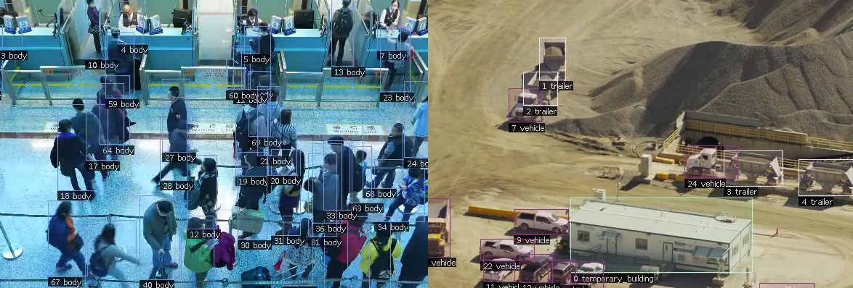

Can you give an example of Computer Vision applications?
Pilot.ai
Location: Palo Alto, CA Employees: 30 Differentiator: End-to-end Powerhouse, both Edge and Cloud
20 billion neurons
Location: Berlin, Germany Employees: 25 Differentiator: Understanding human physical expression
5 Breakthrough Computer Vision Startups to Watch in 2019

Slide 14
What is Computer Vision?
Vision is about discovering from images what is present in
the scene and where it is.
• In Computer Vision a camera (or several cameras) is linked to
a computer.
• The computer interprets images of a real scene to:
• perceive the story behind the image and
• obtain information useful for tasks such as navigation,
manipulation and recognition.
• What is happening?
• What kind of scene?
• Where are the cars?
• How far is the building?
• Can we track the cars?

Slide 15
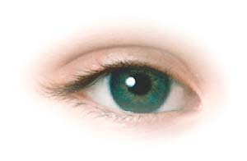


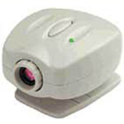
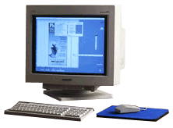
The problem
Want to make a computer understand images
We know it is possible – we do it effortlessly!
Real world scene
Sensing device
Interpreting device
Interpretation
Nature
A butterfly on rocks
Strange color painted stones
An artistic image
Notes:
Sounds easy: we do it effortlessly
Eyes “take the picture” then brain interprets it for us
Want computer to be able interpret digital images

Slide 16
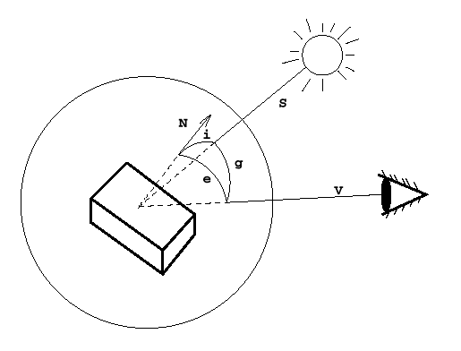
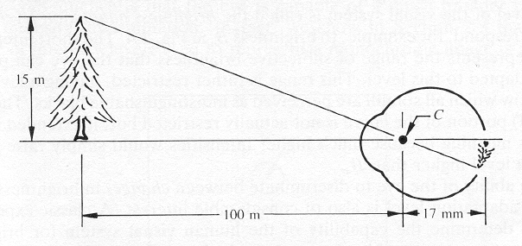
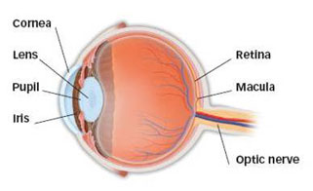
The Human Eye
Retina measures about 5 × 5 cm and contains 10⁸ sampling elements (rods and cones).
The eye’s spatial resolution is about 0.01◦ over a 150◦ field of view.
Intensity resolution is about 11 bits/element, spectral range is 400–700nm.
Temporal resolution is about 100 ms (10 Hz).
Two eyes give a data rate of about 3 GBytes!

Slide 17
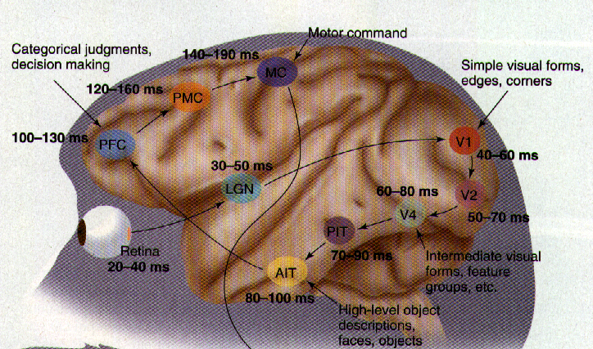
Human visual system
Vision is the most powerful of our own senses.
[Thorpe et. al.]
Around 1/3 of our brain is devoted to processing the signals from our eyes.
The visual cortex has around O(10¹¹) neurons.

Slide 18


Why don’t we just copy the human visual system?
People try to but we don’t yet have a sufficient understanding of how our visual system works.
O(10¹¹) neurons used in vision
By contrast, CPUs have O(10⁹) transistors (most are cache memory).
GPUs – a great news! They have billions of transistors.
Very different architectures:
Brain is slow, but parallel.
Computer is fast, but mainly serial.
Bird vs Airplane
Same underlying principles.
Very different hardware.
Notes:
Researchers do try and simulate what we know about our visual system
- e.g. simple and complex cell responses in V1

Slide 19
Today:
Subject organization
What is Computational Vision?
A little bit of history
Main problems of Computational Vision
Difficulties of the Computational Vision
Applications

Slide 20
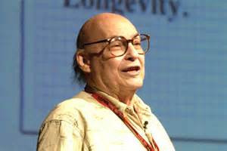
The Vision Story Begins…
In 1966, Marvin Minsky at MIT asked his undergraduate student Gerald Jay Sussman to “spend the summer linking a camera to a computer and getting the computer to describe what it saw”.
We now know that the problem is slightly more difficult than that. (Szeliski 2009, Computer Vision)

Slide 21

Vision...
Mar’s Historical definition
Q: How to answer:
What is this?
R: By a sequence of data transformations.
Surface interference by stereo vision, motion, etc.
Images
2D structures
3D features
3D Solids 3D
Objects
Dice
Image analysis: lines, contours, etc.
Syntactic nature

Slide 22
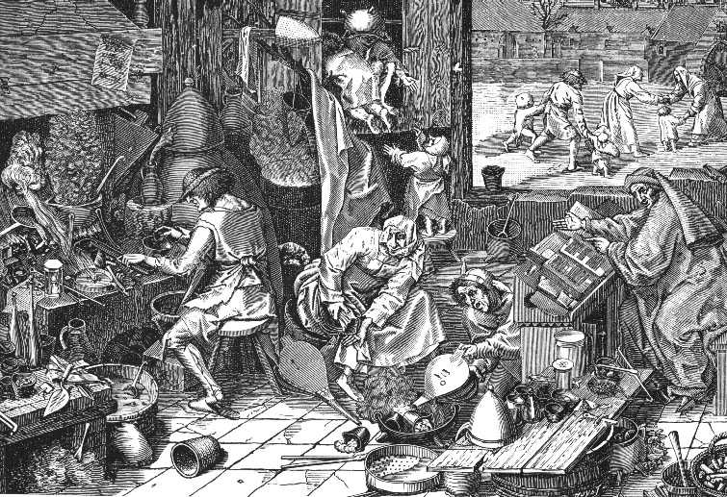
Vision...
But the environment is complex...
...not accessible, continuous, dynamic and non determinist. And this is a BASIC component of the problem...

Slide 23
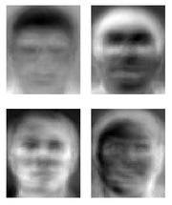
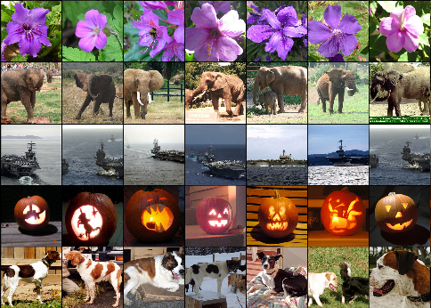
Ridiculously brief history of computer vision
1960’s: interpretation of synthetic worlds
1966: Minsky assigns computer vision as an undergrad summer project
1970’s: some progress on interpreting selected images
1980’s: ANNs come and go; shift toward geometry and increased mathematical rigor
1990’s: face recognition; statistical analysis in vogue
2000’s: broader recognition; large annotated datasets available; video processing starts
2000’s: Deep learning is back to stay, CNN
2010’s: Deep learning beats humans on object recognition
2030’s: robot uprising?
Guzman ‘68
Ohta Kanade ‘78
Turk and Pentland ‘91
Imagenet: 15 mlln of images

Slide 24
Today:
Subject organization
What is Computational Vision?
A little bit of history
Main problems of Computational Vision
Difficulties of the Computational Vision
Applications

Slide 25
Problems of Computer Vision
Computer Vision: A whole series of problems must be solved as steps for the interpretation.

Slide 26
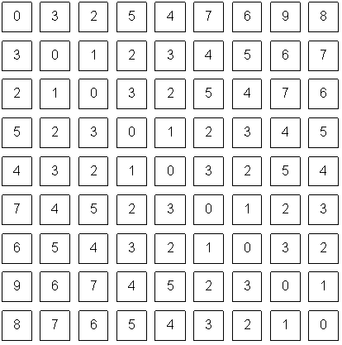
Computer Vision bridges the gap between pixels and “meaning”
What we see
What a computer sees
Source: S. Narasimhan

Slide 27
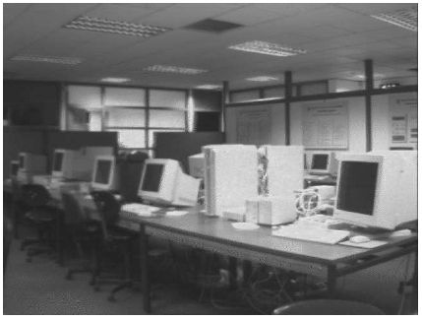
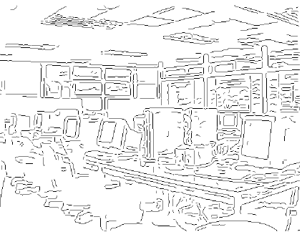
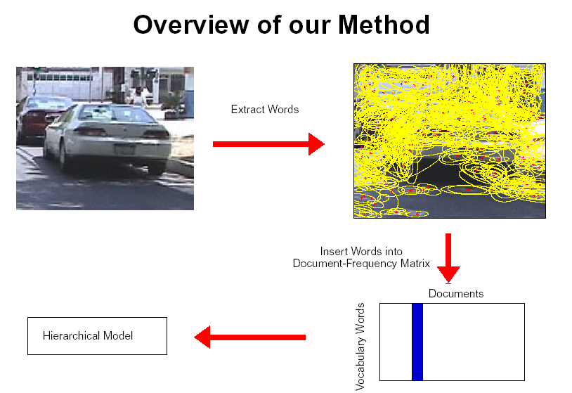
CV problems: Low-Level Feature extraction
Edges, corners
Local regions

Slide 28
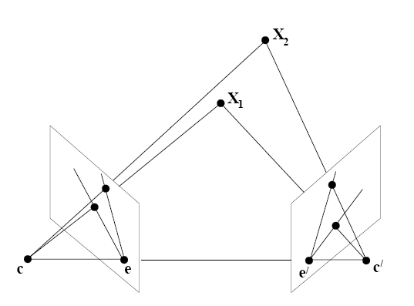
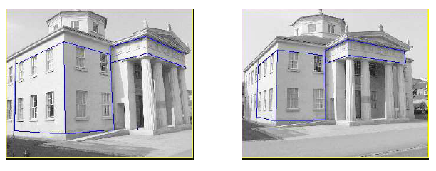
CV problems: Stereo Vision
One of the strategies to infer the 3D structure of the
scene.
•By having two cameras, we can triangulate features
in the left and right images to obtain depth.
•Need to match features between the two images:
• Correspondence Problem

Slide 29
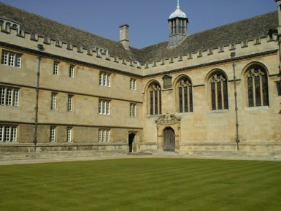
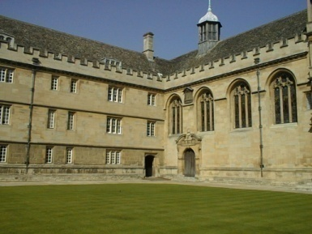
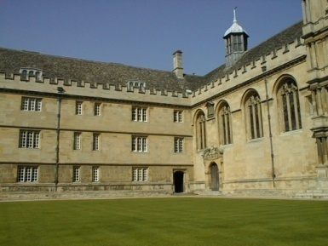
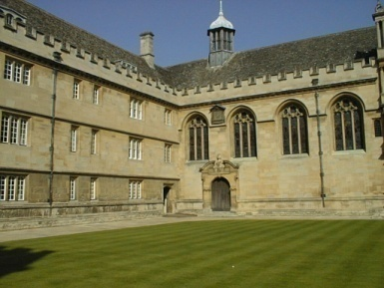
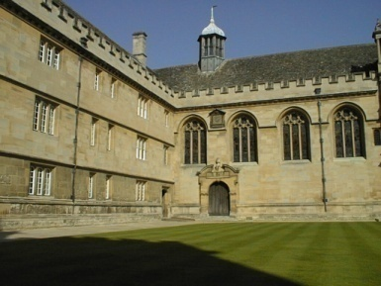
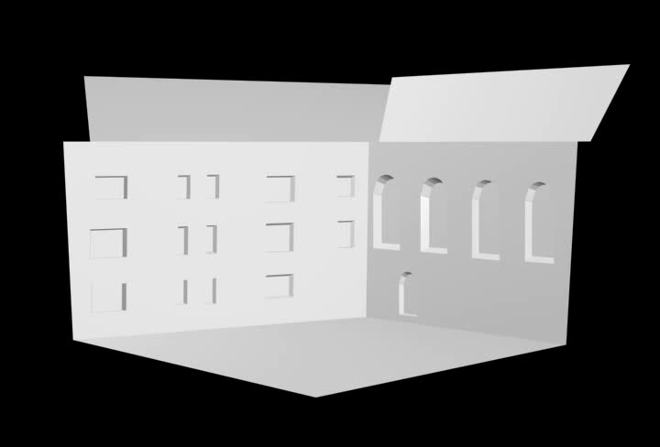
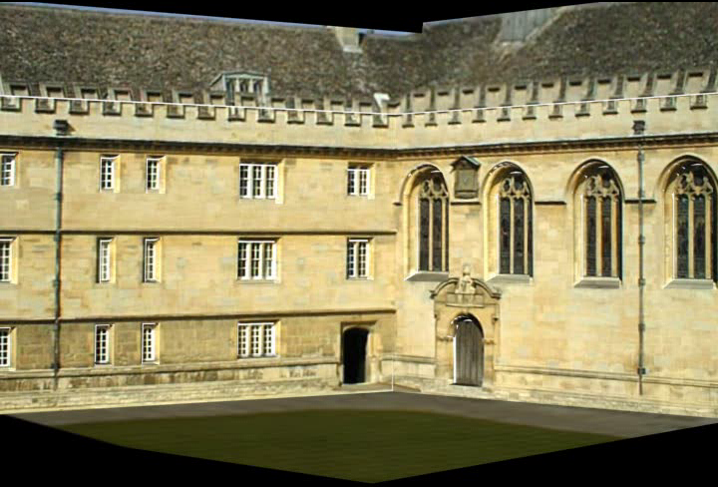
CV problems: Geometry:
3D models of planar objects
Given one or (typically) more images of a scene, or a video, scene reconstruction aims at computing a 3D model of the scene.
[Fitzgibbon et. al]
[Zisserman et. al. ]

Slide 30
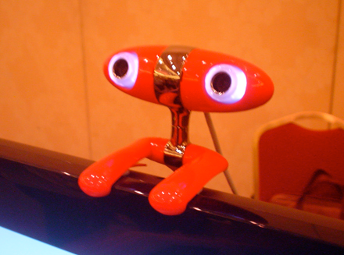
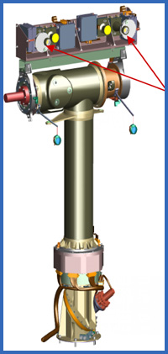
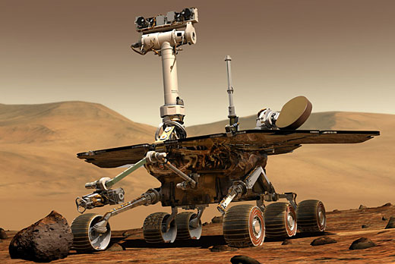
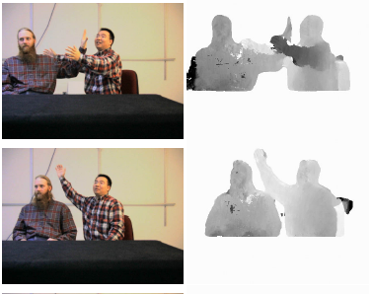
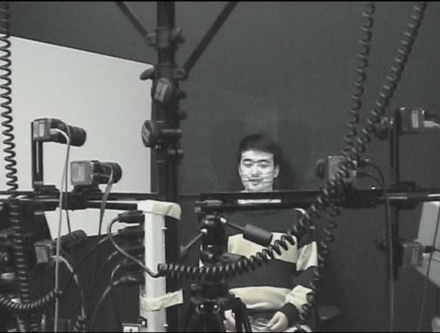
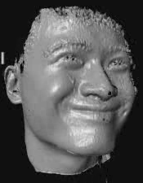
CV problems: 3D reconstruction by a Kinect
Get the 3D shape of the objects

Slide 31
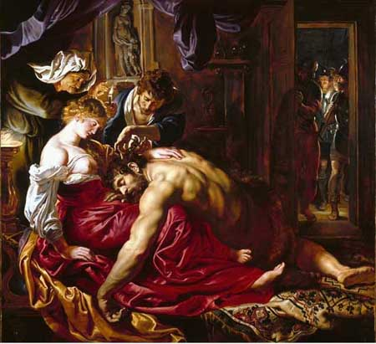
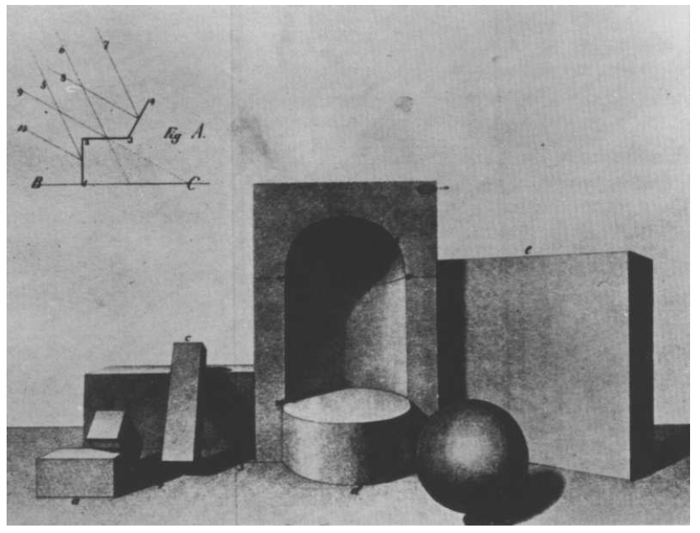
CV problems: Shape from Shading
Recover scene structure from shading in the image

Slide 32
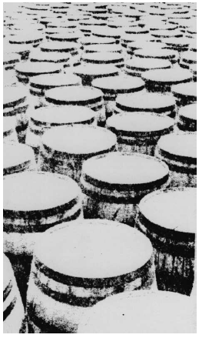
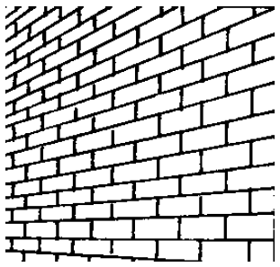
CV problems: Shape from Texture
Texture provides a very strong cue for inferring surface orientation in a single image.
Necessary to assume homogeneous or isotropic texture.
Then, it is possible to infer the orientation of surfaces by analyzing how the texture statistics vary over the image.

Slide 33
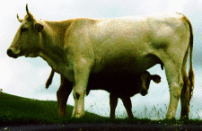
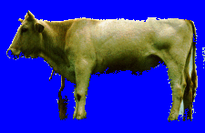
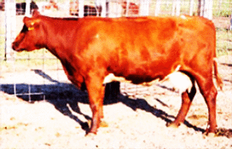
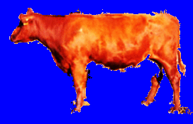
CV problems: Segmentation
Image
Segmentation
It is the process of partitioning an image into multiple segments to simplify the representation and for instance locate objects in the image.

Slide 34
Image Registration
• It is the process of transforming different sets of images into one coordinate system.

Slide 35
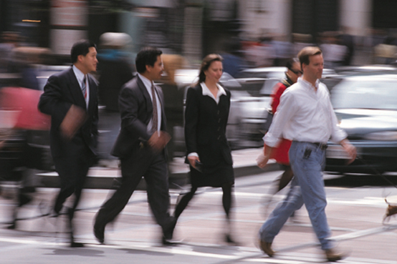
Motion detection and estimation (tracking)
Process of determining motion vectors that describe the
transformation from one image to another from adjacent frames in a video sequence.

Slide 36
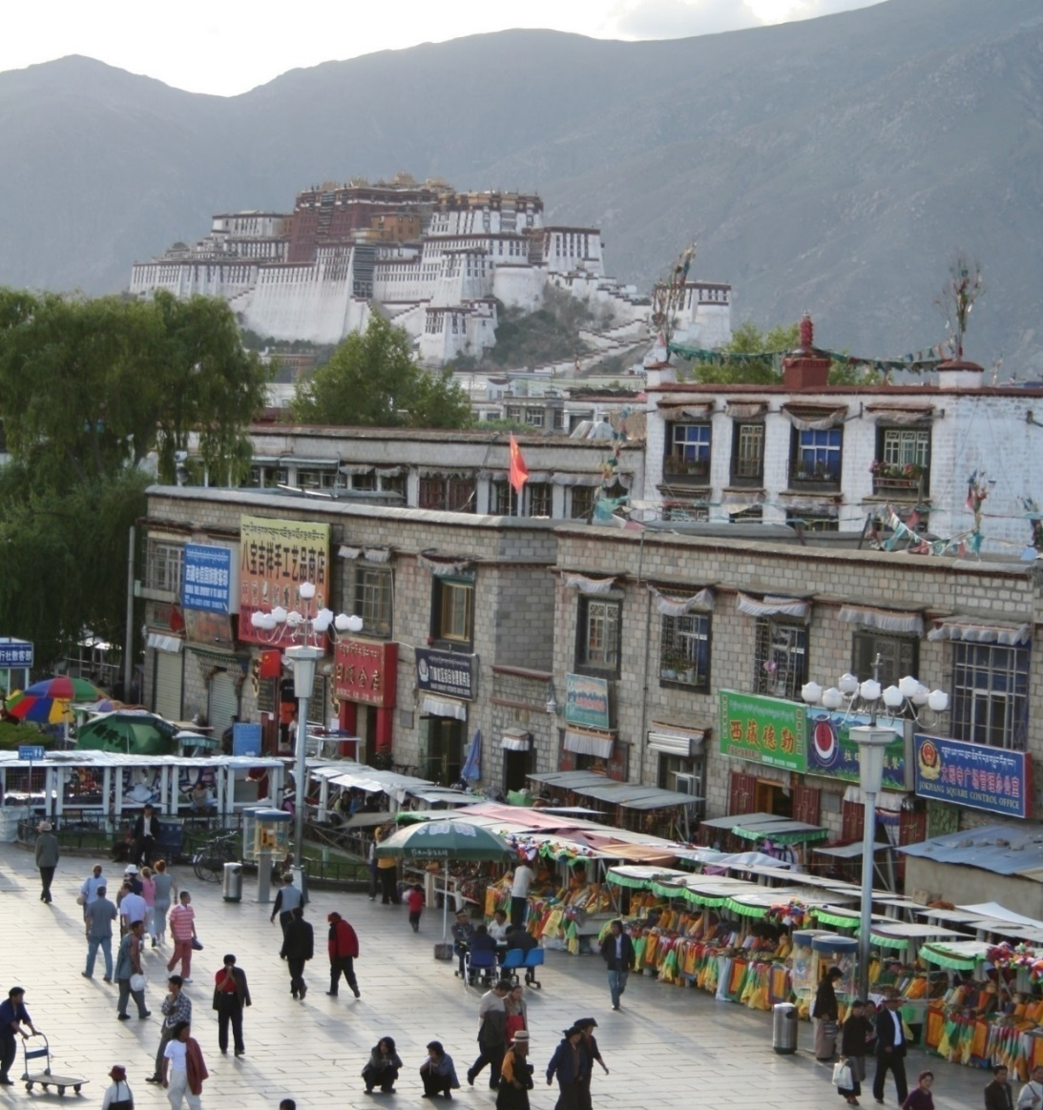
CV problems: Object detection

Slide 37
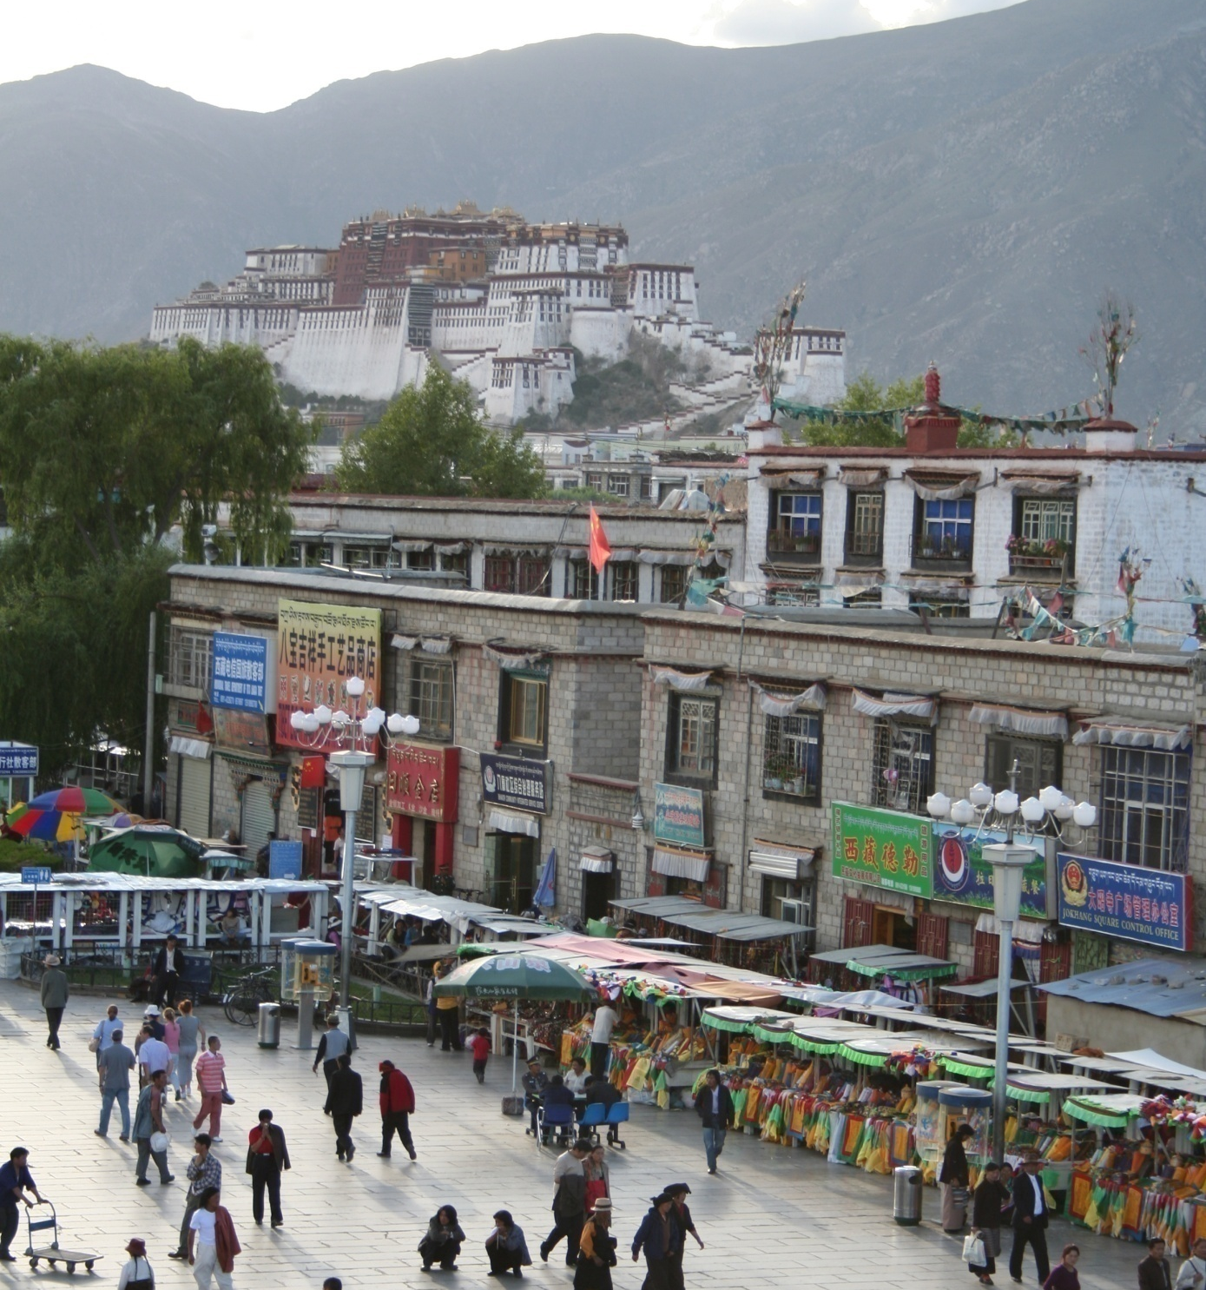
Object categorization
mountain
tree
building
banner
street lamp
vendor
people

Slide 38
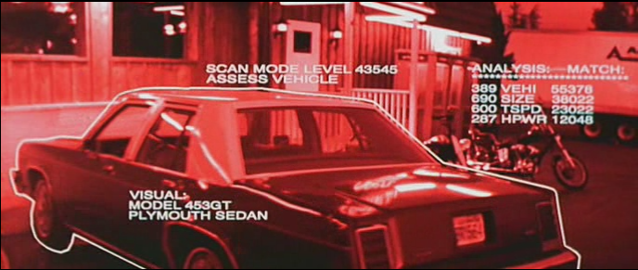
Object and person recognition

Slide 39
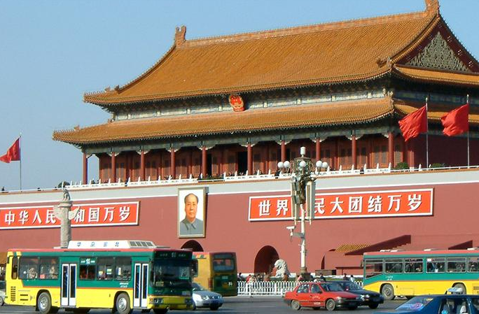
What do humans care about?
slide by Fei Fei, Fergus & Torralba

Slide 40
Verification: is that a bus?
slide by Fei Fei, Fergus & Torralba

Slide 41
Detection: are there cars?
slide by Fei Fei, Fergus & Torralba

Slide 42
Identification: is that a picture of Mao?
slide by Fei Fei, Fergus & Torralba

Slide 43
Object categorization
sky
building
flag
face
banner
wall
street lamp
bus
bus
cars
slide by Fei Fei, Fergus & Torralba

Slide 44
Scene and context categorization
outdoor
city
traffic
…
slide by Fei Fei, Fergus & Torralba

Slide 45
Rough 3D layout, depth ordering
slide by Fei Fei, Fergus & Torralba

Slide 46
Today:
Subject organization
What is Computational Vision?
A little bit of history
Main problems of Computational Vision
Difficulties of the Computational Vision
Applications

Slide 47
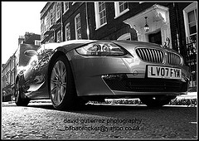
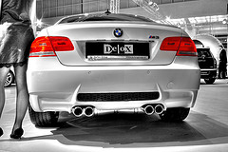
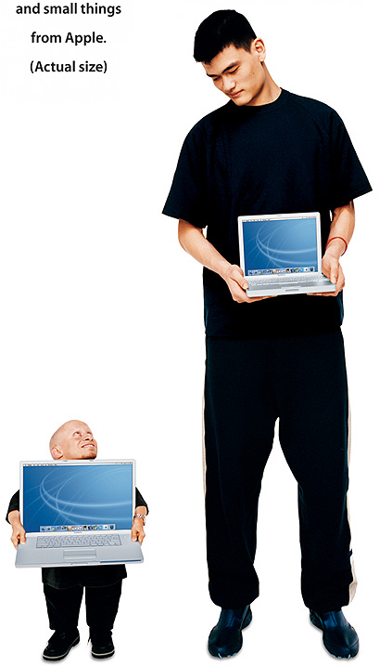
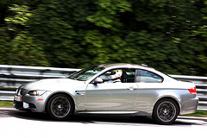



Why is it hard?
Variation of point of view
Scale
IIlumination

Slide 48






Why is it hard?
Movement(Font: S. Lazebnik)
Intra-class variation
Cluttered background
Occlusion

Slide 49


Why is it hard?
Local ambiguity
slide credit: Fei-Fei, Fergus & Torralba

Slide 50

Some things know that you have eyes
Brady, M. J., & Kersten, D. (2003). Bootstrapped learning of novel objects. J Vis, 3(6), 413-422

Slide 51

Bottom-up data analysis
The problem is the ambiguity of the implicit perception
Many 3D scenes can give the same 2D scene
We need information about the World in order to unambiguate the images.
Image source: F. Durand

Slide 52

Is the human perception perfect?
Sinha and Poggio, Nature, 1996
We still don’t understand completely the perception in order to simulate/model/copy it
Notes:
Example where humans make mistakes that computers can avoid

Slide 53

Why is it difficult? Visual illusions
In the visual percepcion different factors intervene associated with aspects of the observer and his/her environment.
The knowledge acquired culturally.
Assumptions about the world acquired for evolution.
Visual memory and past experiences.
The architecture of the human visual system.

Slide 54

Copyright A.Kitaoka 2003

Slide 55
Today
Subject organization
What is Computational Vision?
A little bit of history
Main problems of Computational Vision
Difficulties of the Computational Vision
Applications

Slide 56

Is Artificial vision useful?

Slide 57

Computer vision today
Only a few examples.
Most have less than 15 years!
A very active and changing area
Expected numerous applications the next 5-10 years!
https://angel.co/computer-vision
(1,412 COMPANIES Computer Vision companies)

Slide 58



















Why to study Computer Vision?
Each second million of images are captured and stored
Numerous real applications
Source: S. Lazebnik

Slide 59

Deep learning

Slide 60




Deep learning

Slide 61






Assisted driving
Pedestrian and car detection
meters
Ped
Ped
Car
meters
Lane detection
Collision warning systems with adaptive cruise control,
Lane departure warning systems,
Rear object detection systems,
Slide credit Fei-Fei, Fergus, Torralba CVPR07 Short Course

Slide 62

Medical images and health

Slide 63









Surveillance and security: biometric systems
Fingerprint identification, facial recognition, iris and retinal scan, hand geometry, geometry of the ear, signature recognition, voice identification, identification of the DNS, the smell of human characteristics or recognition of typing motion (not a privilege of science fiction any more).

Slide 64








Surveillance and security: biometric systems
US-VISIT
Border control
3M
Viisage
You are not just being recorded….you are being watched.
Poseidon-Tech
> “Alert!!!
> A Person is forcing
a Ticket Machine!!”

Slide 65










Media and Entertainment
Gaming interfaces
Augmented Reality
ARmusement
Sony EyeToy (for PlayStation .) Allows players to interact with games using motion, color detection and sound.
Digital Fotography
Photosynth (Microsoft LiveLabs)
GestureFX. Gesture Interfaces ground, wall or table.

Slide 66








Media and Entertainment
Augmented TV
PVI: Virtual publicity in real television pictures.
Hawk Eye: tracking the ball in game sports.

Slide 67








Mobile Computer Vision
Client services
For visually impaired
Health services
Android Developer Challenge (Google): Barcode Reader for price list and product information
Tourism

Slide 68





Cultural inheritance
Arqueology
Old documents
Manuscript recognition
3D reconstruction of ceramics
Restauration
Engravings analysis

Slide 69







Improving online search
Query:
street
Organizing photo collections
Slide credit Fei-Fei, Fergus, Torralba CVPR07 Short Course

Slide 70




An example: Amazon farm

Slide 71






Slide 72
Material
Books:
• Rick Szeliski, Computer Vision: Algorithms and Applications,
• David Forsyth and Jean Ponce, Computer Vision: A Modern Approach,
• Dictionary of Computer Vision and Image Processing, by Fisher et al.
• Lot's of papers

